Slide 1


Группа 319
Специальность 09.02.07
Информационные системы и программирование

Slide 2
Это Руслан
Это Настя

Slide 3
Конкурс социальных инициатив «Твори добро»
Группа 319
Специальность 09.02.07
Информационные системы и программирование

Slide 4
Цель проекта
Популяризация добровольчества через доступные всем дела

Slide 5

Направления волонтерской деятельности
Социальное волонтерство
Экологическое волонтерство
Событийное волонтерство
Спортивное волонтерство
Культурное волонтерство
Волонтерство общественной безопасности
Медиаволонтерство
Волонтерство в медицине
Патриотическое волонтерство
Донорство

Slide 6
Задачи
01
02
03
Организация выезда в приют для животных с целью оказания помощи и ухода за животными
Сбор канцелярских принадлежностей для детей и молодёжи с тяжёлыми заболеваниями
Сотрудничество с благотворительным фондом для обеспечения адресной доставки собранных товаров нуждающимся

Slide 7

Этапы реализации
01
02
03
04
Этап 1
Этап 2
Этап 3
Этап 4
Подготовка
Выезд к животным
Сбор канцелярии
Сотрудничество с благотворительнымфондом

Slide 8
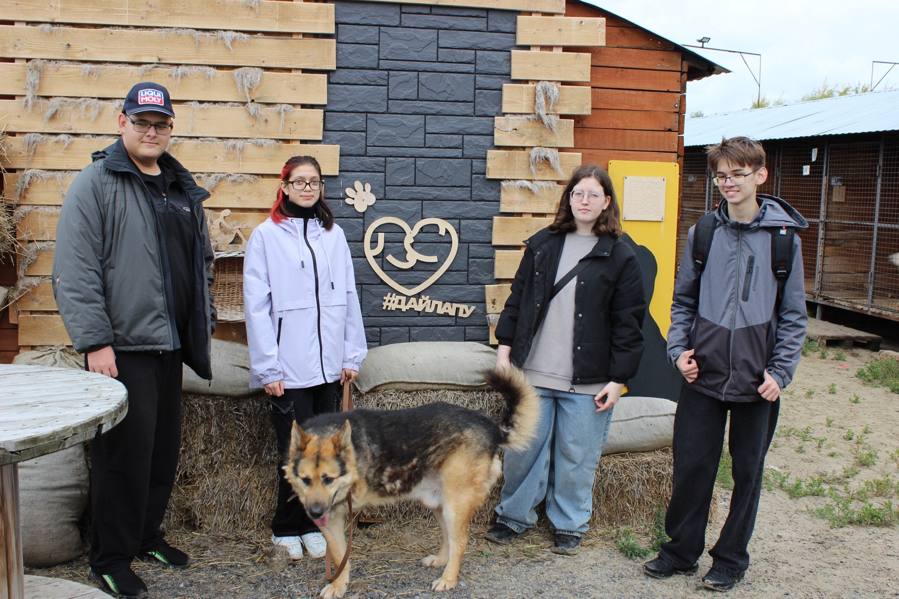
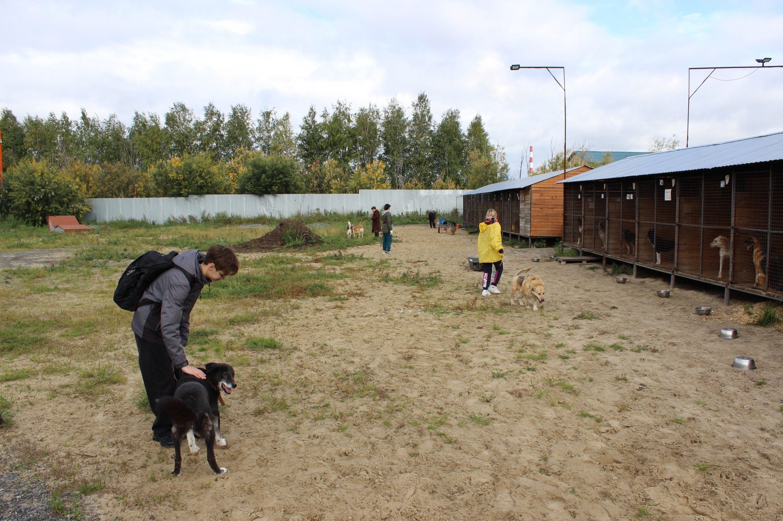
«Дай Лапу»

Slide 9
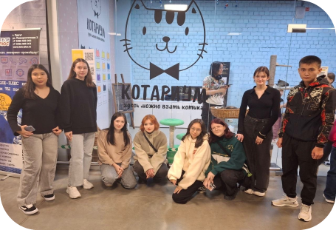
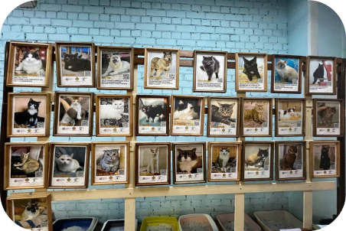
«Котариум»

Slide 10
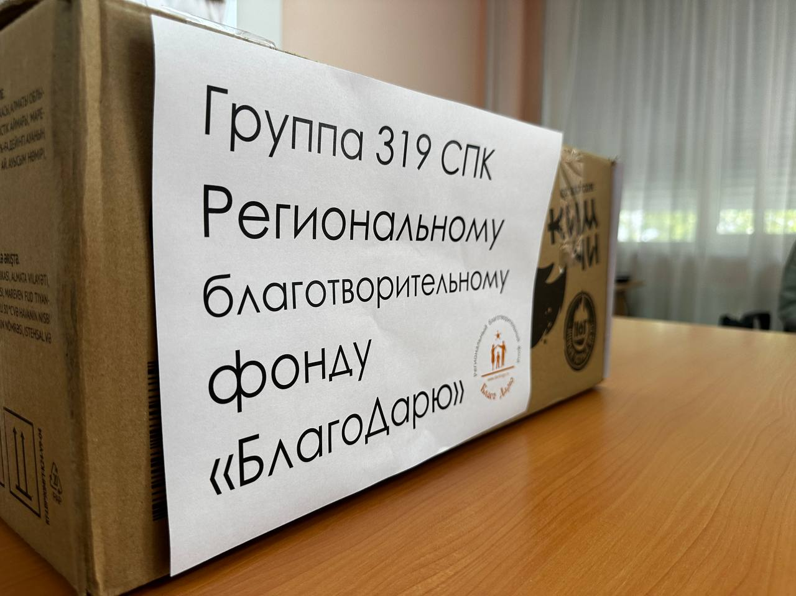
«Благо Дарю»
Список канцелярии:
Пластилин 3 шт
Гуашь 5 шт
Шариковые ручки 4 шт
Простые карандаши 3 шт
Набор линеек 2 шт
Набор ластиков 1 шт
Карандаши цв 7 шт
Фломастеры 2 шт
Клей карандаш 2 шт
Альбомы 5 шт
Лёгкий пластилин 2 шт
Акварель медовая 2 шт

Slide 11
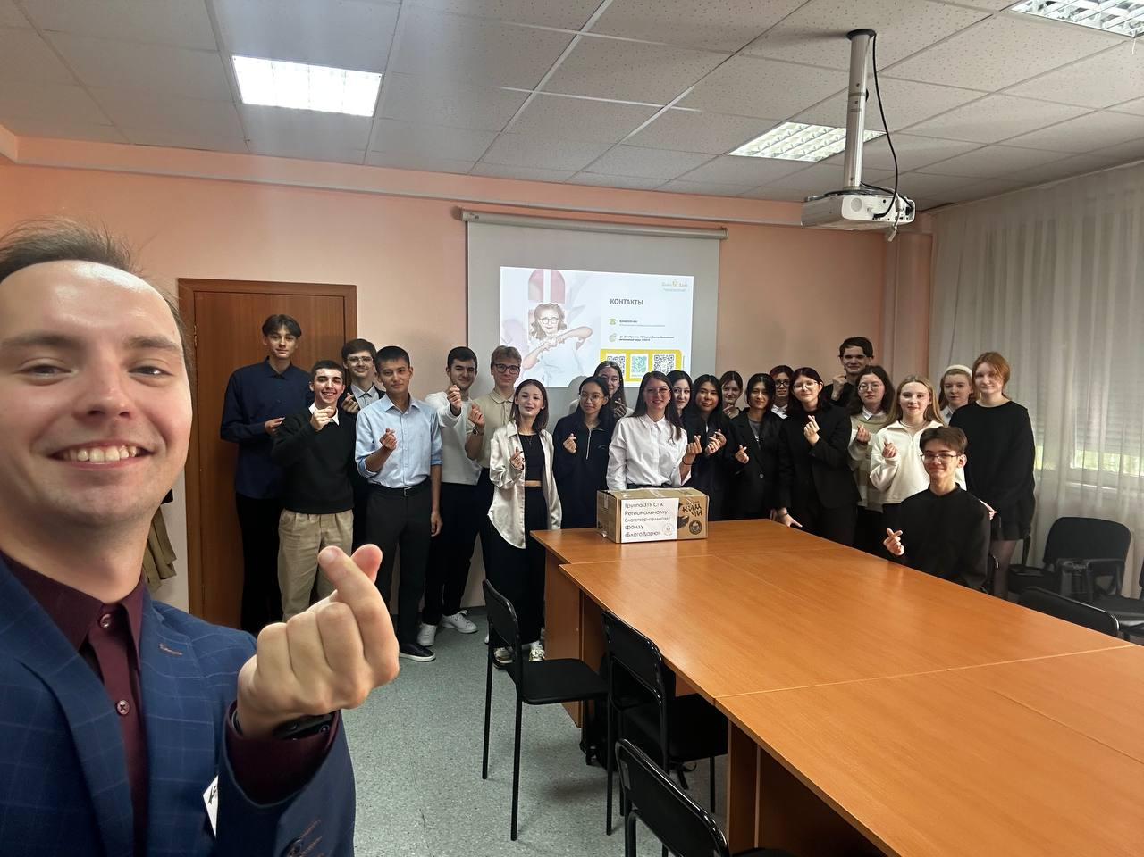
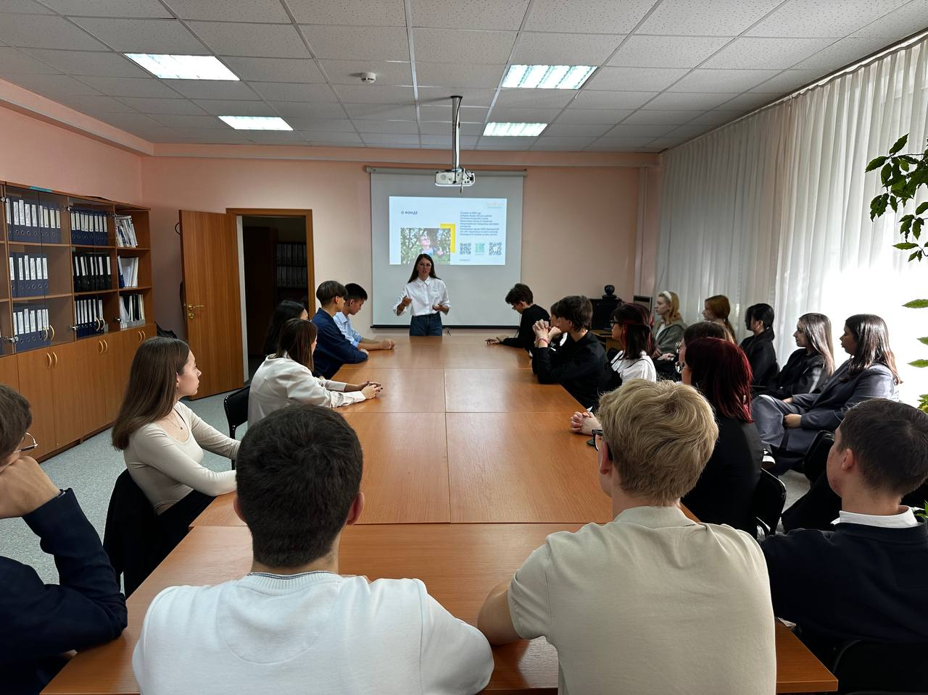
«Благо Дарю»

Slide 12
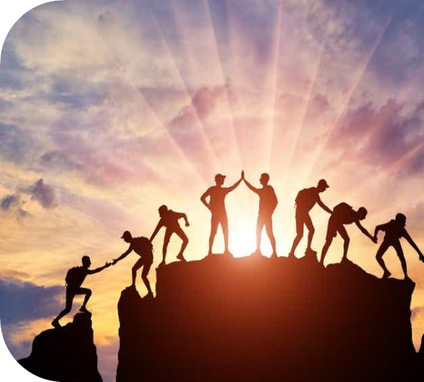

Ожидаемые и достигнутые результаты
● Улучшение условий содержания животных в приютах ● Повышение осведомленности молодёжи о важности заботы о животных ● Обеспечение нуждающихся детей необходимыми канцелярскими принадлежностями ● Повышение осведомлённости молодёжи о работе благотворительных фондов

Slide 13


Slide 15
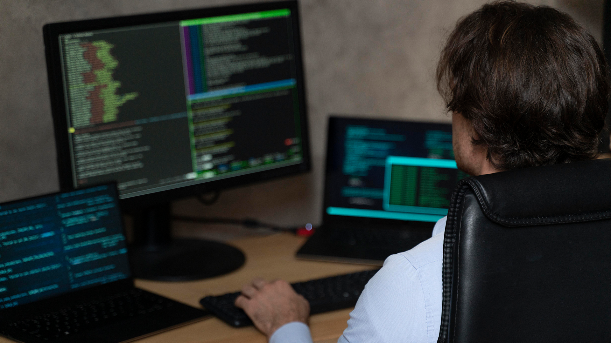
A picture is worth a thousand words

Slide 16

Introduction
You can give a brief description of the topic you want to talk about here. For example, if you want to talk about Mercury, you can say that it’s the smallest planet in the entire Solar System

Slide 17

01
Mathematics
You can enter a subtitle here if you need it

Slide 18
Overview
Mercury
Venus
Mercury is the closest planet to the Sun and the smallest one in the Solar System—it’s only a bit larger than the Moon
Venus has a beautiful name and is the second planet from the Sun. It’s hot and has a poisonous atmosphere

Slide 19
About the major
Venus
Jupiter
Mars
Saturn
Venus is the second planet from the Sun
It’s the biggest planet in the Solar System
Despite being red, Mars is a cold place
Saturn is a gas giant and has several rings

Slide 20
Introduction to mathematics
Venus
Jupiter
Venus is the second planet from the Sun
It’s the biggest planet in the Solar System
Mathematics infographics
Mars
Saturn
Despite being red, Mars is a cold place
Saturn is a gas giant and has several rings

Slide 21
What is discrete mathematics?
Mercury
Jupiter
It’s the closest planet to the Sun
Jupiter doesn’t have a solid surface
Venus
Earth
Saturn
Venus is the second planet from the Sun
Earth is the planet where we all live on
Saturn was named after a Roman god
Mars
Neptune
Despite being red, Mars is very cold
Neptune is very far away from the Sun

Slide 22
Introduction to computer science
Mercury
Mars
Venus
It’s the closest planet to the Sun and the smallest in the Solar System
Despite being red, Mars is actually a cold place. It’s full of iron oxide dust
Venus has a beautiful name and is the second planet from the Sun

Slide 23
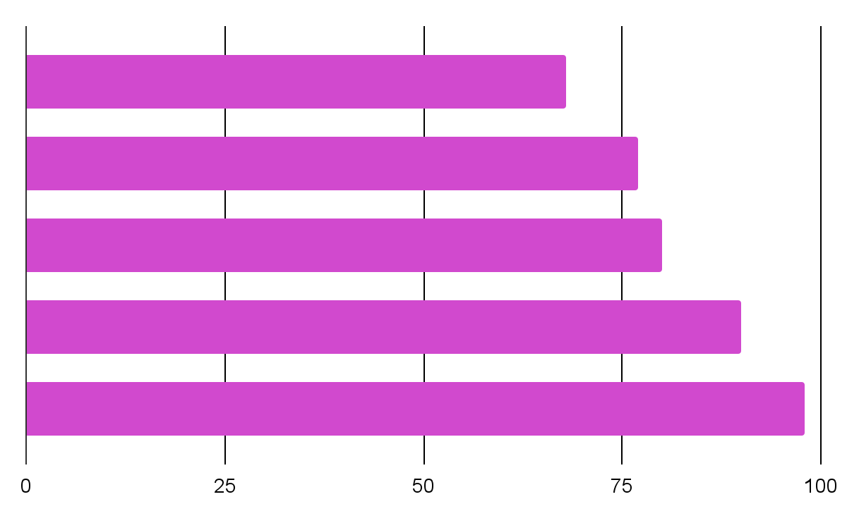
Programming tools
Mercury
Venus
Mars
Most used tools
Jupiter
Venus has a beautiful name and is the second planet from the Sun
Saturn
Follow the link in the graph to modify its data and then paste the new one here. For more info, click here

Slide 24

9h 55m 23s
333,000
Jupiter's rotation period
The Sun’s mass compared to Earth’s

Slide 25
Some porcentages
15%
25%
Venus
Jupiter
50%
75%
Mars
Saturn
Venus is the second planet from the Sun
It’s the biggest planet in the Solar System
Despite being red, Mars is a cold place
Saturn is a gas giant and has several rings

Slide 26
What is linear algebra?
Mercury
Venus
Jupiter
Saturn
Mars
Neptune
It’s the closest planet to the Sun
Venus is the second planet from the Sun
Jupiter is the biggest planet of them all
It’s composed of hydrogen and helium
Mars is actually a very cold place
It’s the farthest planet from the Sun

Slide 27
About linear algebra
Venus
Jupiter
Venus is the second planet from the Sun
It’s the biggest planet in the Solar System
Mars
Saturn
Despite being red, Mars is a cold place
Saturn is a gas giant and has several rings

Slide 28
Introduction to number theory
Mercury | Venus | Mars
Mercury is the smallest planet of them all | Venus is extremely hot, even more than Mercury | Despite being red, Mars is actually a cold place
Earth is the beautiful planet where we all live on | Jupiter is a gas giant and the biggest planet | Saturn is composed of hydrogen and helium
Neptune is the farthest planet from the Sun | Pluto is now considered a dwarf planet | Ceres is located in the main asteroid belt

Slide 29
Graph theory
Mercury
Venus
It’s the closest planet to the Sun and the smallest of them all
Venus has a beautiful name, but also high temperatures
Earth is the beautiful planet where we all live on
Despite being red, Mars is actually a very cold place
Venus has a beautiful name, but also high temperatures
Jupiter is the biggest planet in the Solar System
Saturn is the second-largest planet in the Solar System
Neptune is the fourth-largest planet in the Solar System

Slide 30
Graph theory
Mercury
Venus
It’s the closest planet to the Sun and the smallest of them all
Venus has a beautiful name, but also high temperatures
Earth is the beautiful planet where we all live on
Despite being red, Mars is actually a very cold place
Venus has a beautiful name, but also high temperatures
Jupiter is the biggest planet in the Solar System
Saturn is the second-largest planet in the Solar System
Neptune is the fourth-largest planet in the Solar System

Slide 31
Graph theory definitions
Graph | Venus has a beautiful name, but also high temperatures
Adjacent | Earth is the beautiful planet where we all live on
Bipartite graph | Despite being red, Mars is actually a very cold place
Connected | Jupiter is the biggest planet in the Solar System
Chromatic number | Saturn is the second-largest planet in the Solar System
Cycle | Neptune is the fourth-largest planet in the Solar System
Vertex Degree | The Sun is the star at the center of the Solar System
Multigraph | Pluto is now considered a dwarf planet

Slide 32
Graph theory infographic
Venus
Jupiter
Venus is the second planet from the Sun
It’s the biggest planet in the Solar System
Mars
Saturn
Despite being red, Mars is a cold place
Saturn is a gas giant and has several rings

Slide 33

Planar graphs

Slide 34
Eulerian path and circuits
Step A
Step C
Mercury is the closest planet to the Sun and the smallest of them all
Despite being red, Mars is actually a cold place. It’s full of iron oxide dust
Step B
Venus has a beautiful name and is the second planet from the Sun

Slide 35
Important concepts
Mercury
Venus
It’s the closest planet to the Sun
Venus is the second planet from the Sun
Jupiter
Saturn
Jupiter is the biggest planet of them all
Saturn is not the only planet with rings
Mars
Neptune
Mars is actually a very cold place
It’s the farthest planet from the Sun

Slide 36
Best colleges in the world
Mercury
It’s the closest planet to the Sun and the smallest in the Solar System
Mars
Despite being red, Mars is actually a cold place. It’s full of iron oxide dust

Slide 37

Desktop software
You can replace the image on the screen with your own work. Just right-click on it and select “Replace image”

Slide 38
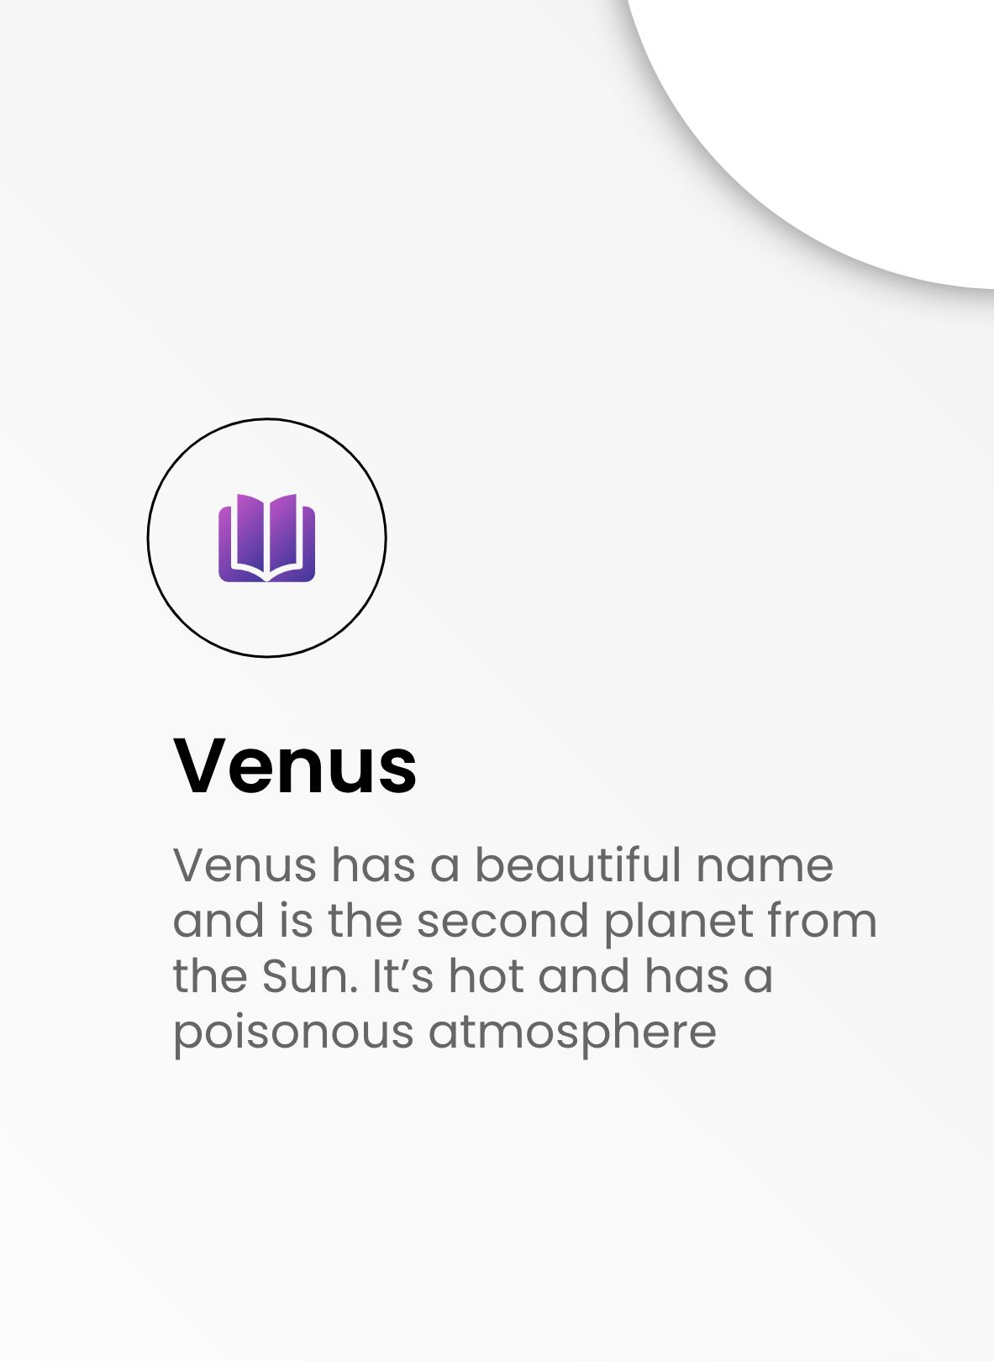
Table app
You can replace the image on the screen with your own work. Just right-click on it and select “Replace image”

Slide 39

Our team
Susan Bones
Jenna Doe
You can speak a bit about this person here
You can speak a bit about this person here

Slide 40
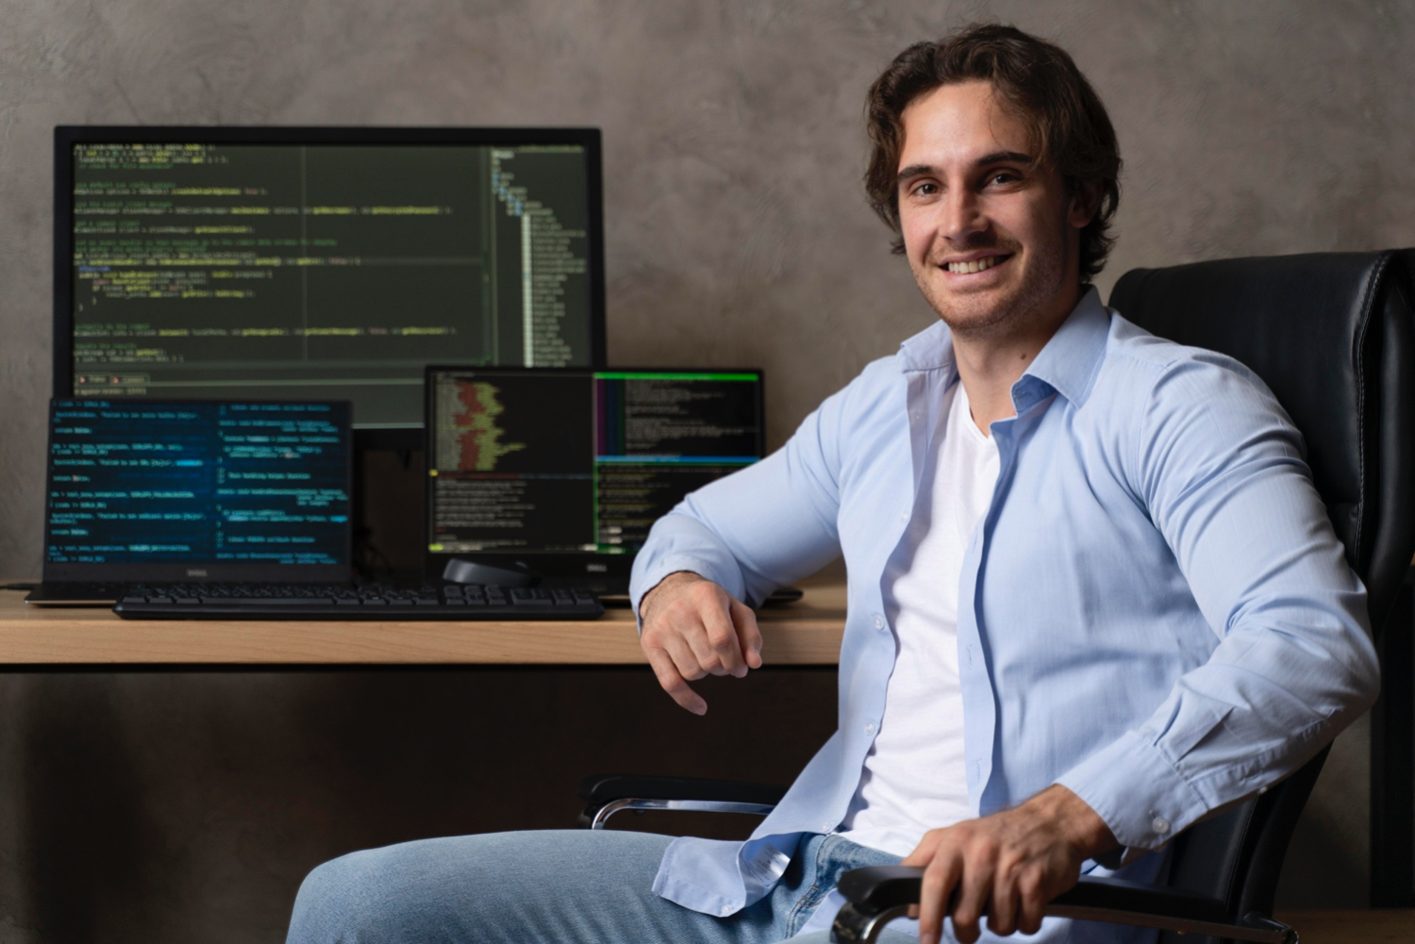
Thanks!
Do you have any questions?
youremail@freepik.com
+91 620 421 838
yourwebsite.com
Please keep this slide for attribution

Slide 41
Resources
Did you like the resources on this template? Get them for free at our other websites:
Photos
Medium shot man typing on laptop
Close up hands typing on keyboard
Close up programmer typing on keyboard
Man typing on the keyboard
Smiley man working on laptop from home
Woman using laptop
Woman attending online class
Close-up of woman typing on a laptop
Medium shot programmer sitting on chair
Young blonde woman working from home on the floor
Beautiful women working together in a startup company
Vectors
Flat design minimal technology facebook post
Social network infographic

